Slide 1
Lecture 16
Virtual Memory

Slide 2
Objectives
To describe the benefits of a virtual memory system
To explain the concepts of demand paging and page-replacement algorithms

Slide 3
Background
Virtual memory – separation of user logical memory from physical memory.
  Only part of the program needs to be in memory for execution
  Logical address space can therefore be much larger than physical address space
  Allows address spaces to be shared by several processes
  Allows for more efficient process creation
Virtual memory can be implemented via:
  Demand paging
  Demand segmentation

Slide 4
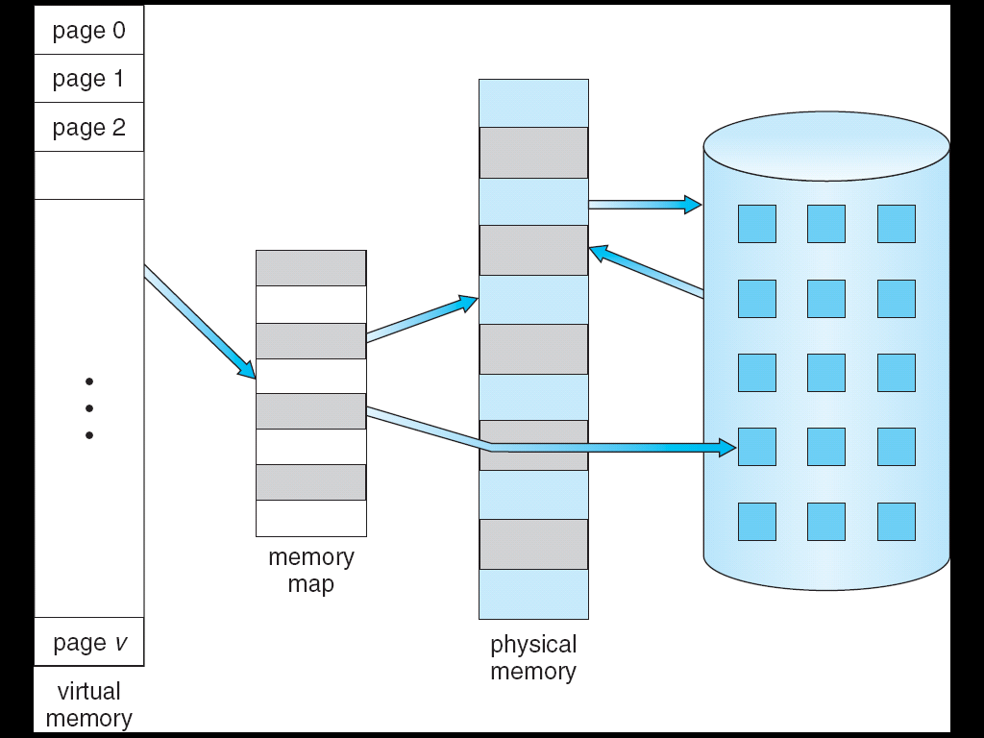
Virtual Memory That is Larger Than Physical Memory
⇒

Slide 5

Virtual-address Space

Slide 6
Demand Paging
Bring a page into memory only when it is needed
  Less I/O needed
  Less memory needed
  More users
Page is needed ⇒ reference to it
  invalid reference ⇒ abort
  not-in-memory ⇒ bring to memory

Slide 7
Valid-Invalid Bit
With each page table entry a valid–invalid bit is associated
(v ⇒ in-memory, i ⇒ not-in-memory)
Initially valid–invalid bit is set to i on all entries
Example of a page table snapshot:
During address translation, if valid–invalid bit in page table entry
is i ⇒ page fault
Frame #
valid-invalid bit
v
v
v
v
i
….
i
i
page table

Slide 8
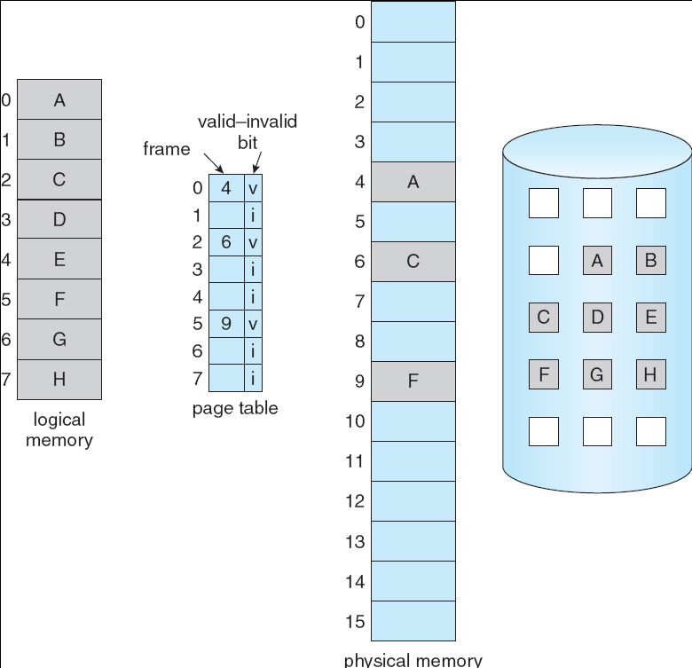
Page Table When Some Pages Are
Not in Main Memory

Slide 9
Page Fault
If there is a reference to a page, first reference to that page will trap to operating system:
page fault
Operating system looks at another table to decide:
  Invalid reference ⇒ abort
  Just not in memory
Get empty frame
Swap page into frame
Update tables
Set validation bit = v
Restart the instruction that caused the page fault

Slide 10

Steps in Handling a Page Fault

Slide 11
Performance of Demand Paging
Page Fault Rate 0 ≤ p ≤ 1.0
  if p = 0 no page faults
  if p = 1, every reference is a fault
Effective Access Time (EAT)
EAT = (1 – p) x memory access
+ p (page fault overhead
+ swap page out
+ swap page in
+ restart overhead)

Slide 12
Demand Paging Example
Memory access time = 200 nanoseconds
Average page-fault service time = 8 milliseconds
EAT = (1 – p) x 200ns + p (8 milliseconds)
= (1 – p) x 200ns + p x 8,000,000
= 200ns + p x 7,999,800
If one access out of 1,000 causes a page fault, then
EAT = 8.2 microseconds.
This is a slowdown by a factor of 40!!

Slide 13
Basic Page Replacement
Find the location of the desired page on disk
Find a free frame:
- If there is a free frame, use it
- If there is no free frame, use a page replacement algorithm to select a victim frame
Bring the desired page into the (newly) free frame; update the page table
Restart the instruction

Slide 14

Basic Page Replacement (contd.)

Slide 15
Basic Page Replacement (contd.)
Use modify (dirty) bit to reduce overhead of page transfers – only modified pages are written to disk
Page replacement completes separation between logical memory and physical memory – large virtual memory can be provided on a smaller physical memory

Slide 16
Page Replacement Algorithms
Want lowest page-fault rate
Evaluate algorithm by running it on a particular string of memory references (reference string) and computing the number of page faults on that string
In all our examples, the reference string is
1, 2, 3, 4, 1, 2, 5, 1, 2, 3, 4, 5

Slide 17

Graph of Page Faults Versus The Number of Frames

Slide 18

FIFO Page Replacement

Slide 19
FIFO Page Replacement
Reference string: 1, 2, 3, 4, 1, 2, 5, 1, 2, 3, 4, 5
3 frames (3 pages can be in memory at a time per process)
4 frames
Belady’s Anomaly: more frames ⇒ more page faults
1
1
4
5
2
2
1
3
9 page faults
3
3
2
4
1
1
5
4
2
2
1
5
10 page faults
3
3
2
4
4
3

Slide 20

FIFO Illustrating Belady’s Anomaly

Slide 21
Optimal Page Replacement
Replace page that will not be used for longest period of time
4 frames example
1, 2, 3, 4, 1, 2, 5, 1, 2, 3, 4, 5
How do you know this?
Used for measuring how well your algorithm performs
1
4
2
6 page faults
3
4
5

Slide 22

Optimal Page Replacement

Slide 23
Least Recently Used (LRU) Algorithm
Reference string: 1, 2, 3, 4, 1, 2, 5, 1, 2, 3, 4, 5
1
1
1
1
5
2
2
2
2
2
3
5
5
4
4
4
4
3
3
3

Slide 24

LRU Page Replacement

Slide 25
LRU Algorithm (Cont.)
Counter implementation
  Every page entry has a counter; every time page is referenced through this entry, copy the clock into the counter
  When a page needs to be changed, look at the counters to determine which are to change
Stack implementation – keep a stack of page numbers in a double link form:
  Page referenced:
    move it to the top
    requires 6 pointers to be changed
  No search for replacement

